Slide 2
What’s new in 10.0.46 ( Plus MCP )
Nathan Clouse

Slide 3

Nathan Clouse
Sr. Technical Architect @ HSO
Based out of Detroit, MI
Worked with AX / F&O for 18 years
Microsoft Business Applications MVP 6X
www.atomicax.com
www.dynamics.fo
NathanClouseAX on LinkedIn
nclouse@hso.com nathan.clouse@gmail.com

Slide 4
Out of Preview in .46
Acceptance sampling
Advanced quality management
Approved customer list

Slide 5
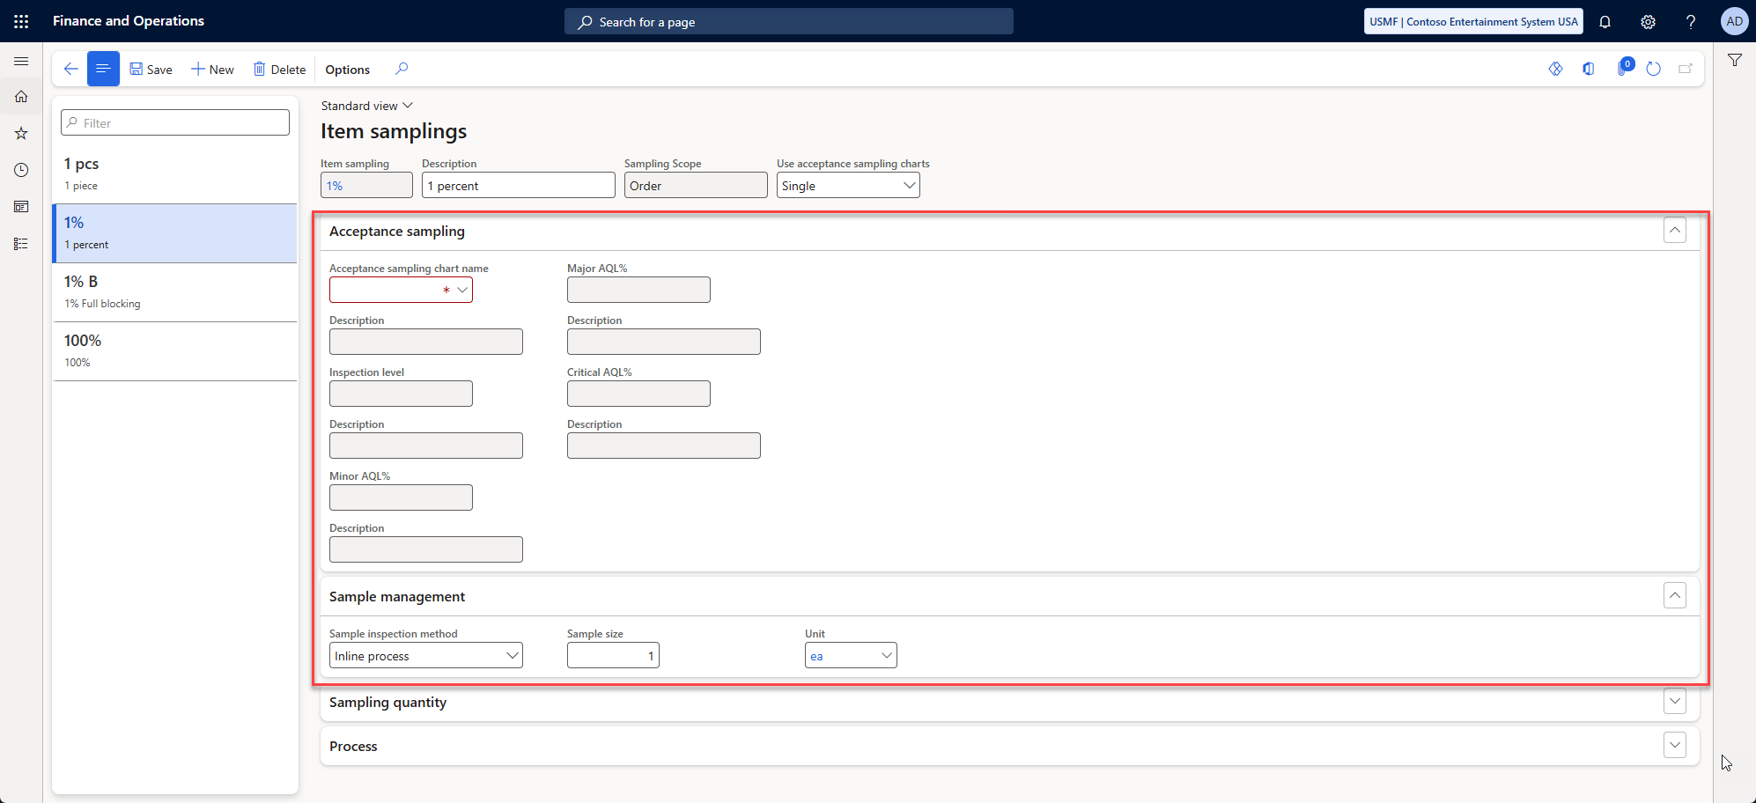
Acceptance sampling

Slide 6
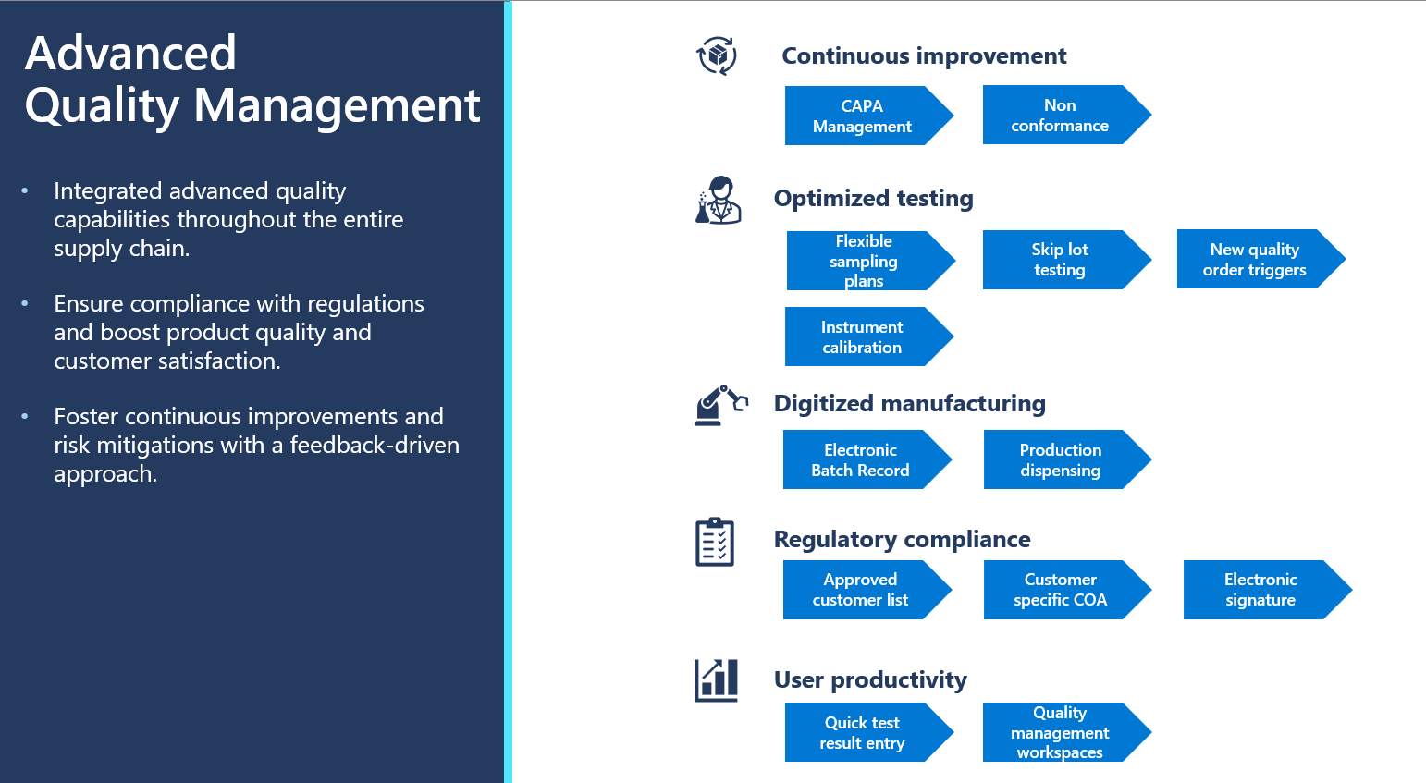
Advanced quality management
https://learn.microsoft.com/en-us/dynamics365/supply-chain/inventory/advanced-quality-management-overview

Slide 7
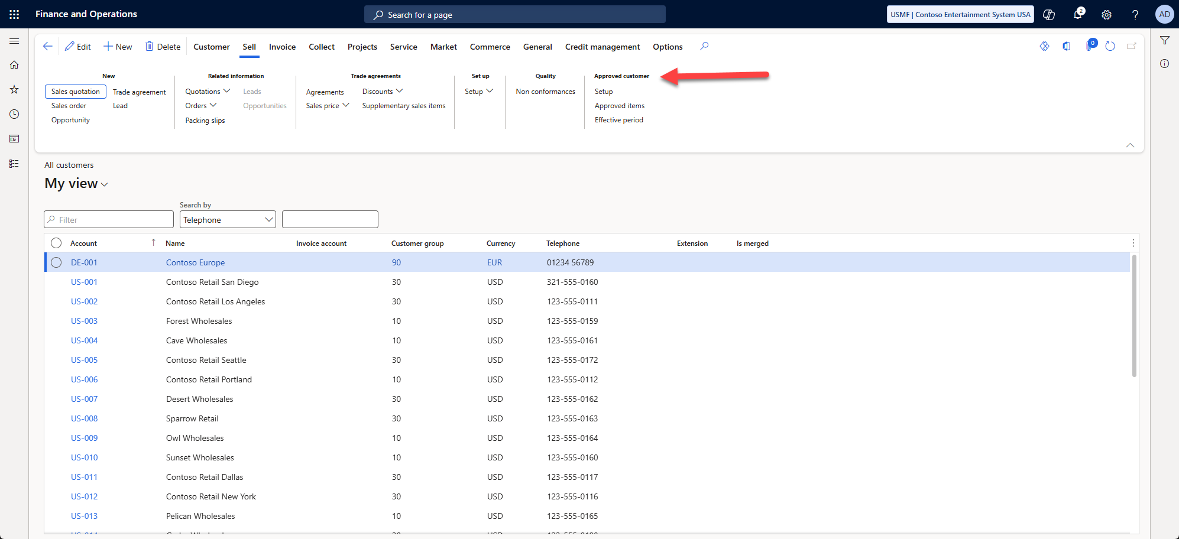
Approved customer list

Slide 8
Honorable Mentions
(Production Ready Preview) Account reconciliation agent
(Production Ready Preview) Agent management
(Production Ready Preview) Immersive Home
(Production Ready Preview) Send follow-up emails to vendors with Supplier Communications Agent - automatically sending emails
(Production Ready Preview) Supplier Communications Agent

Slide 9
In Preview in .46
(Preview) Ability to expire jobs and job titles
(Preview) Optional linking of test instruments to maintainable assets
(Preview) Sample management
(Preview) Record test results from the production floor execution interface

Slide 10
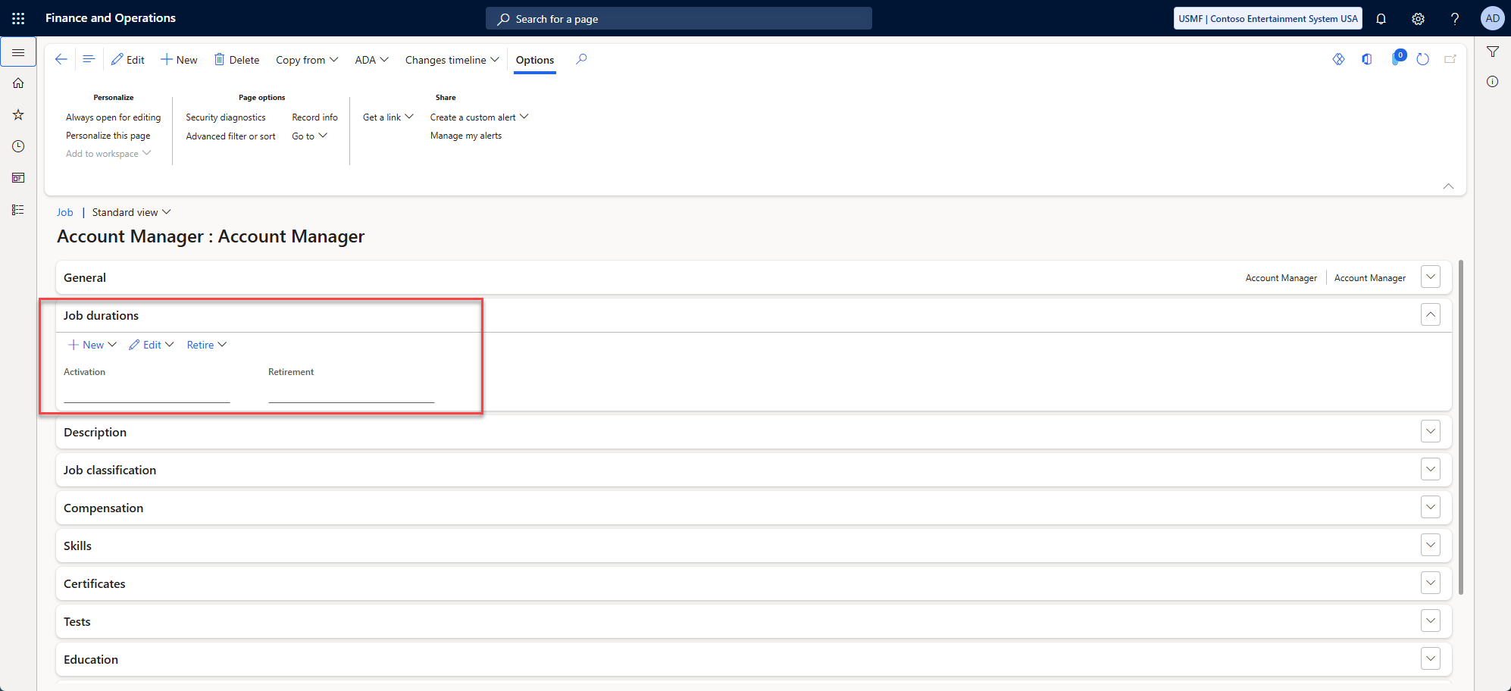
(Preview) Ability to expire jobs and job titles

Slide 11
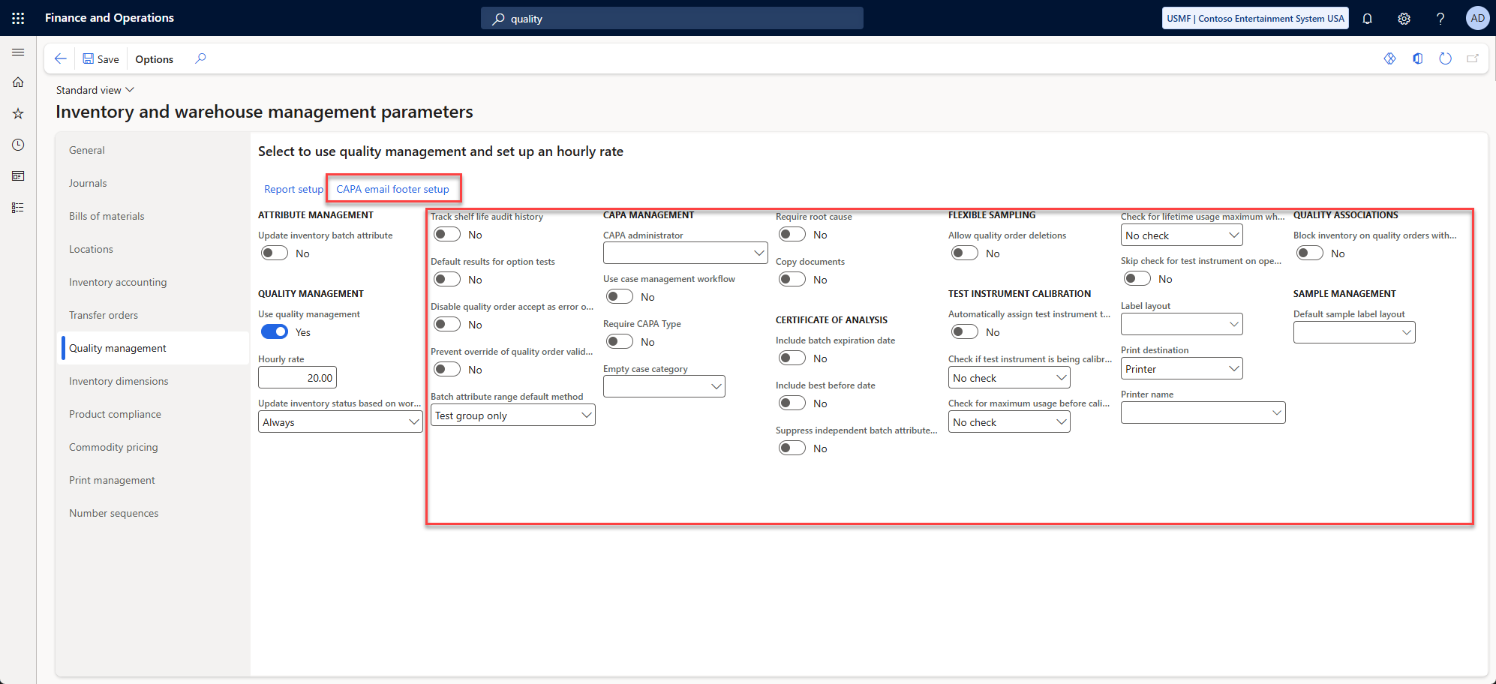
(Preview) Sample management

Slide 12
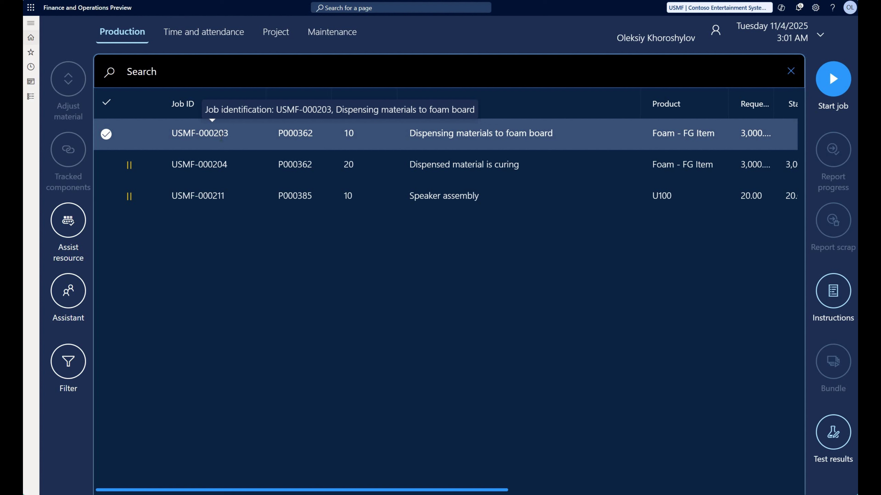
Record test results from the production floor execution interface
Notes:
https://www.youtube.com/watch?v=-7QJcmazXyc

Slide 13
Project Operations
Preview
Enable beginning balances in Project Operations Integrated with ERP
Enable line discounts and additional fee for Project Operations integrated with ERP based scenarios

Slide 14
Globalization
(Poland) JPK Audit File for Fixed Assets Reporting
(Preview) [Italy] Fiscal Journal modernization in Electronic Reporting
(Preview) [Sweden] Standard Import and Export (SIE) modernization in Electronic Reporting
(Preview) Meet requirements of Tax reform in Brazil in 2026

Slide 15
Performance Improvements
Unified pricing management pricing rule performance enhancement
(Preview) Performance Improvements for Deferral Recognition Batch
Customer interest note creation – top picking optimization

Slide 16
Fixed Assets
Actual Acquisition Date for migrated fixed assets
Inventory sold on the invoice line

Slide 17
General Ledger
Enable additional validation of data for documents using the source document accounting framework
Ships “Mandatory”

Slide 18
Administration
(Preview) Dynamics 365 ERP Model Context Protocol server
Unified Application User Feature

Slide 19
Issues
Issue: 1078359
Issue: 1063678

Slide 20
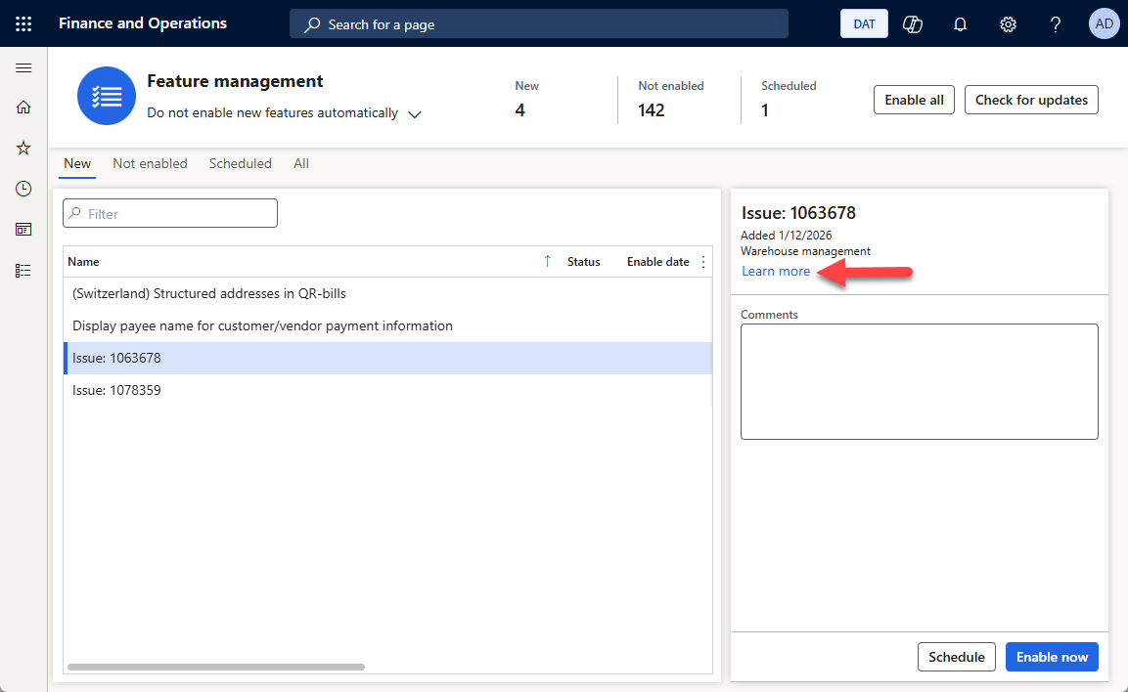
Issues

Slide 21
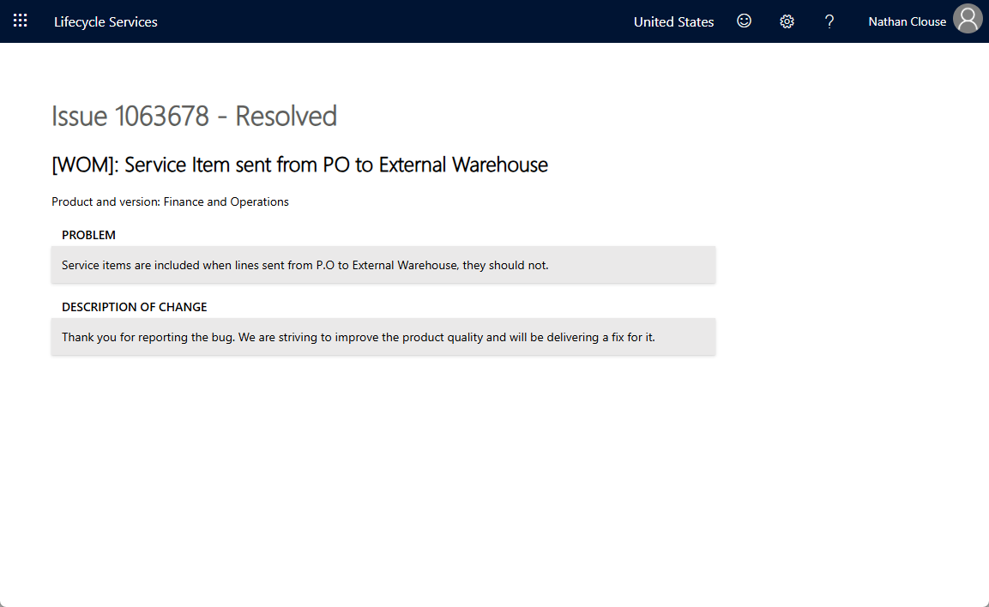
Issues

Slide 22
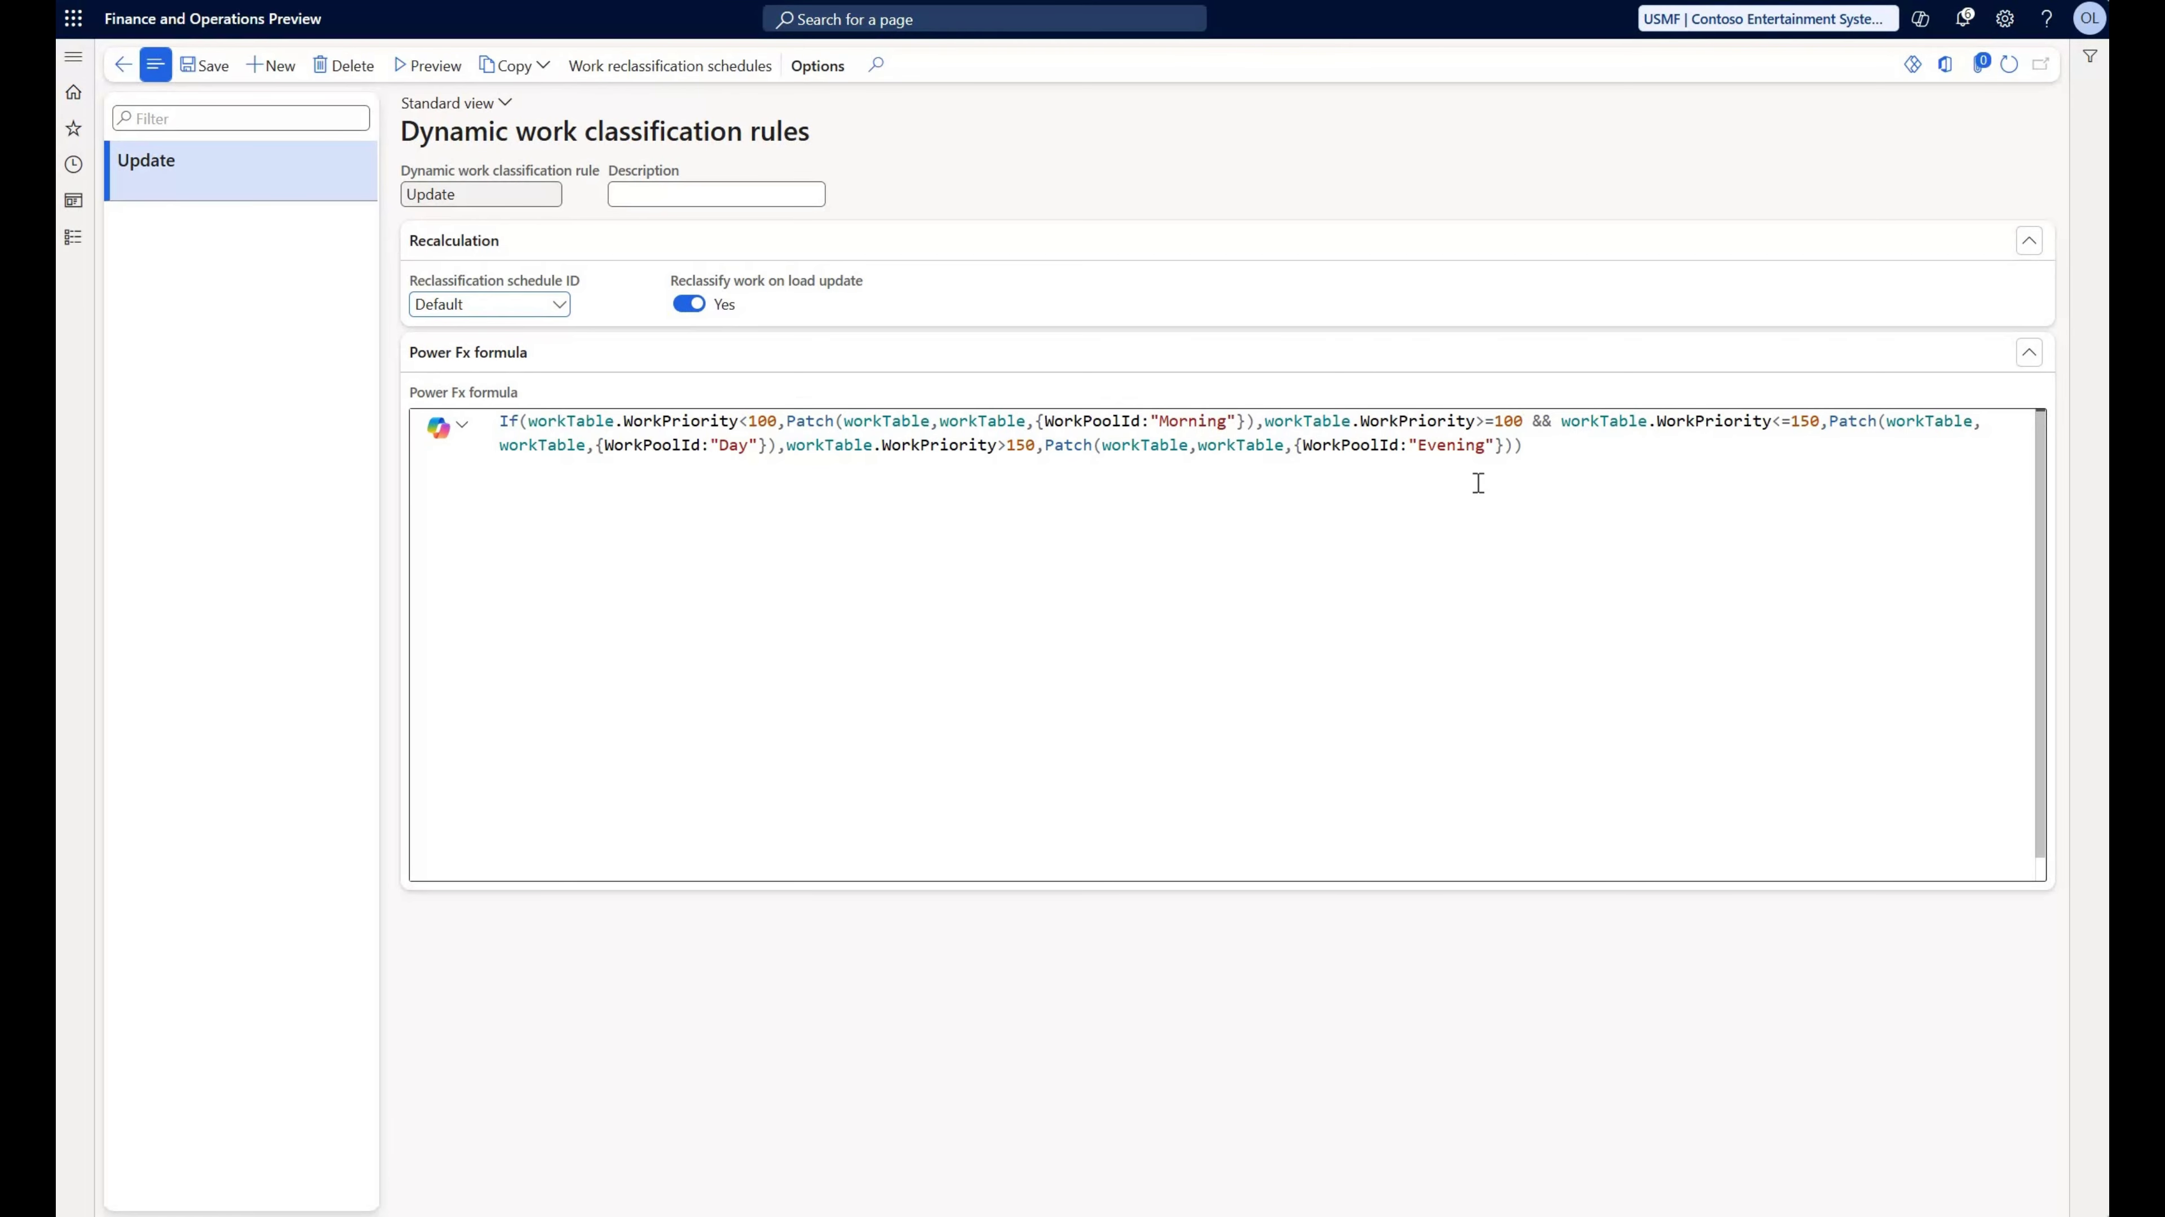
(Preview) Dynamic work classification

Slide 24
Enable foreign trade parameters for all countries

Slide 25
Cross-company data sharing for products
“This feature cannot be turned off once it has been enabled.”
Requires “Master company data sharing”
Master company data sharing requires a flight, have to contact support

Slide 26
(Preview) Dynamics 365 ERP Model Context Protocol server

Slide 27


Slide 28
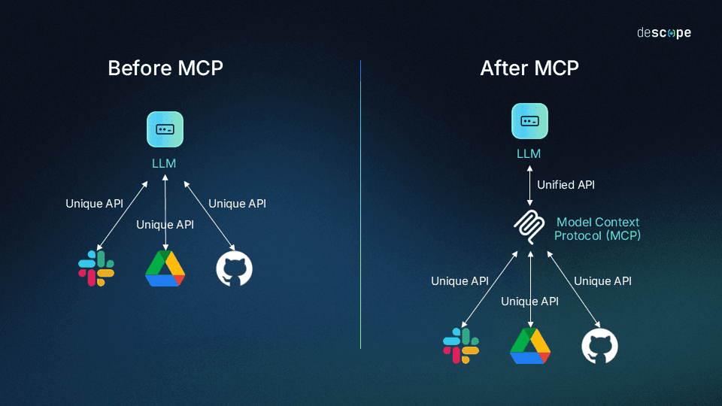
What Is Model Context Protocol (MCP)?
MCP is an open standard that defines a common language for how AI agents and tools connect to applications and data sources such as Dynamics 365.
It standardizes how context is provided to large language models and AI agents.
Notes:
Think of MCP as the “USB-C” for AI and ERP systems — a universal connector that eliminates custom code and brittle API integrations.

Slide 29
Notes:
Think of MCP as the “USB-C” for AI and ERP systems — a universal connector that eliminates custom code and brittle API integrations.

Slide 30
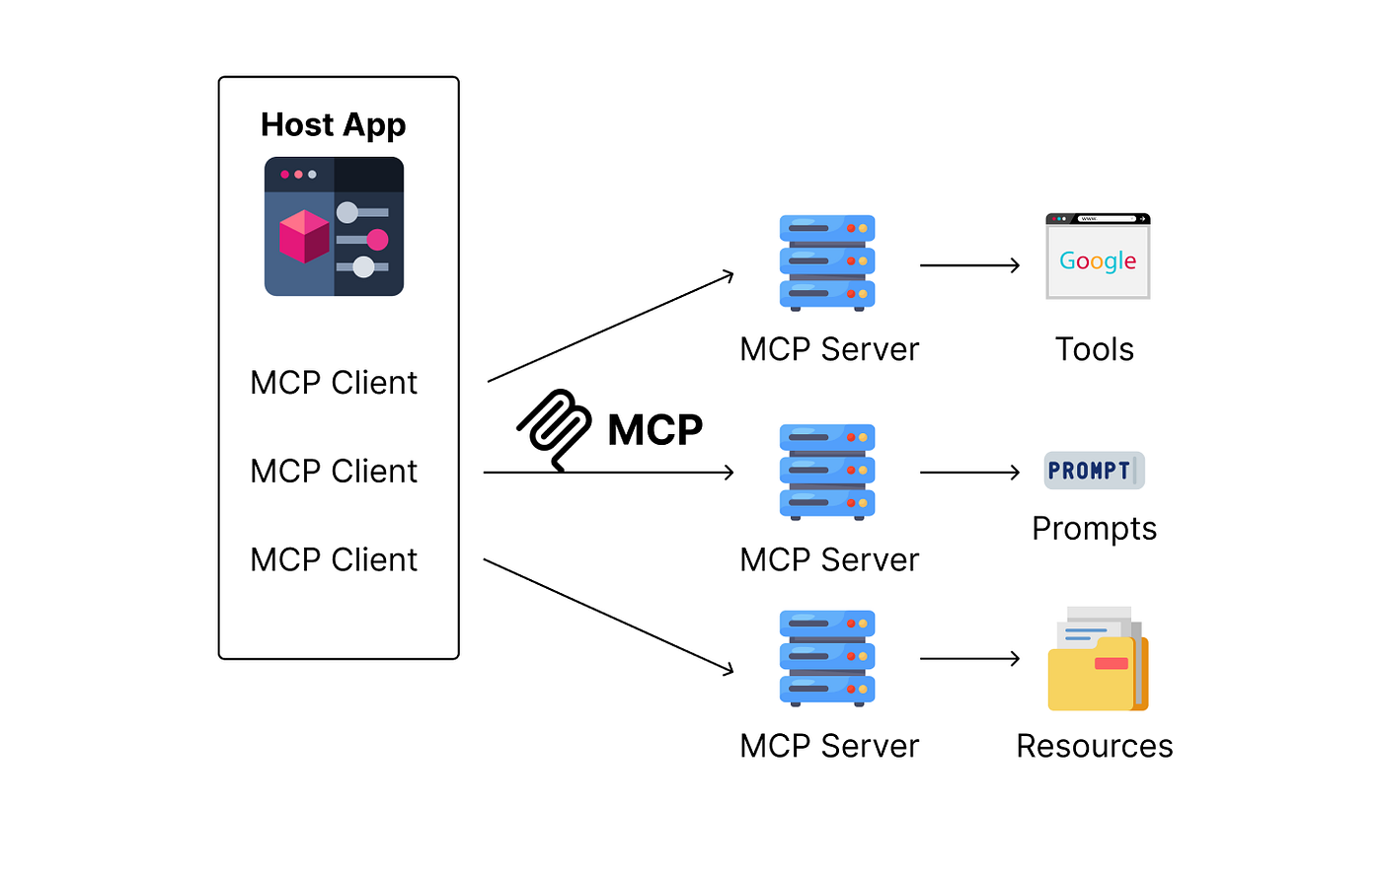
How It Works
A dynamic framework that enables AI agents to interact with ERP data and business logic in Dynamics 365 Finance and Operations apps.
Agents can perform tasks without needing custom code, connectors, or bespoke APIs.
Notes:
It gives agents the same ERP capabilities a human user has — with context and security — but in automated form.

Slide 31
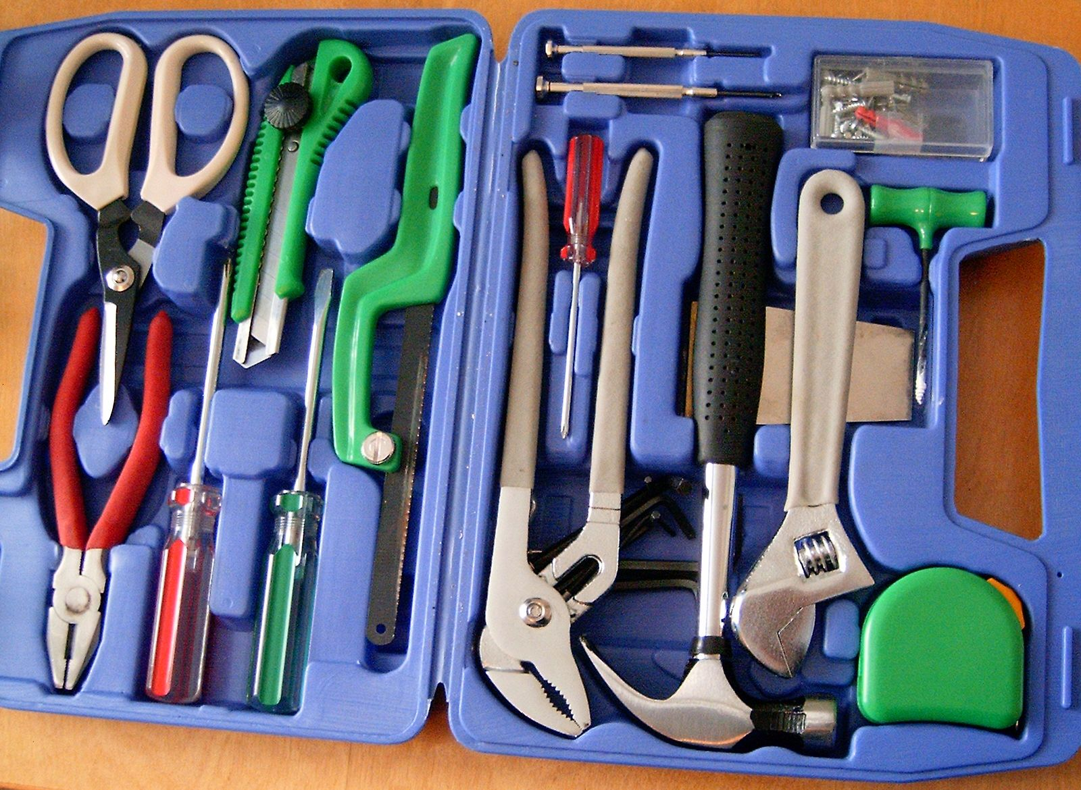
MCP Tools
Tool name | Description
click_control | Select a control or a subelement of a control on the form. Clicking on a subelement of a control is done through the actionId parameter.
close_form | Close form
filter_form | Applies a filter on the form
filter_grid | Filter on a grid
find_menu_item | Find a menu item
find_actions | Finds actions available to invoke
invoke_action | Invokes an action
open_lookup | Open a lookup control on the form
open_menu_item | Opens menu item
open_or_close_tab | Open or close a tab on the form
save_form | Saves form
select_grid_row | Select a row in a grid
set_control_value | Set the value of a field
sort_grid_column | Sort a grid by a grid column

Slide 32

What It Enables
Agents can orchestrate ERP workflows across multiple systems using a single protocol.
You no longer need custom connectors per system.
Real-world capability examples:
  Query inventory
  Validate vendor data
  Automate purchase requisitions

Slide 33

Requirements
Dynamics 365 Finance and Operations environment version must be current (10.0.2428.15+)
Enable Dynamics 365 ERP Model Context Protocol Server in Feature Management
Agent platforms must be allowed via the Allowed MCP Clients form
Environment must be Tier 2+ or Unified Developer Environment (not CHE)

Slide 34

Limitations & Considerations
Currently preview feature — not for production use yet.
Only US English supported in MCP responses.
Dates and numerics use ISO format

Slide 35

Questions?

Slide 36
Nathan Clouse
Sr. Technical Architect @ HSO
Based out of Detroit, MI
Worked with AX / F&O for 18 years
Microsoft Business Applications MVP 6X
www.atomicax.com
www.dynamics.fo
NathanClouseAX on LinkedIn
nclouse@hso.com
nathan.clouse@gmail.com
https://github.com/NathanClouseAX/CommunityPresentations

